Slide 1

Leveraging Climate Data To Optimize Travel Recommendation
Presented By: KANDELA VAMSHI
Batch: 436

Slide 2
About me
Name: Kandela Vamshi
Qualification :
  Currently pursuing a Master of Computer Applications from NRIM College
My Profile:
AS A Passionate on Making “Data into Meaningful insight”
LinkedIn :
www.linkedin.com/in/kandela-vamshi-2b4457258
GitHub :
https://github.com/Vamshikandela/Vamshikandela

Slide 3
Agenda
Problem
Business Problem
Objective of the Project
Tools & Modules Used
Challenges Faced
Data Collection and Data Understanding
Data Preprocessing(Cleaning)
Exploratory Data Analysis (EDA)
Evaluation(Hypothesis Testing)
Conclusion (Key finding overall)
Q&A

Slide 4
PROBLEM
A traveller wants to plan an international vacation but prefers destinations that fall within a comfortable temperature range Weather conditions vary significantly across countries and seasons, making it difficult to manually evaluate which country is suitable at a given time .
Time-and-date websites provide historical and current weather data (date-wise temperature records), but this data is:
Spread across multiple pages
Time-dependent

Slide 5
BUSINESS PROBLEM
Travel recommendation platforms often suggest destinations without considering real-time and historical climate conditions. As a result:
Travelers experience unexpected weather conditions (extreme heat, extreme cool).
This leads to poor travel experiences and dissatisfaction.
Trip cancellations increase due to unfavorable climate during travel dates.
Repeat bookings decrease, impacting customer loyalty and revenue.

Slide 6
PROJECT OBJECTIVE
Leverage historical and real-time climate data to enhance travel recommendations
Match destinations with traveller climate preferences for better comfort
Reduce trip cancellations caused by unfavourable weather conditions
Improve customer satisfaction and repeat bookings through smarter personalization

Slide 7
Tools & Modules Used
Selenium Automation Tool (Dynamic Website Scraping)
Regex (Patterns Using Meta Characters )
Pandas (Data Manipulation)
Seaborn (Visualization)
Matplotlib.pyplot (Visualization)

Slide 8
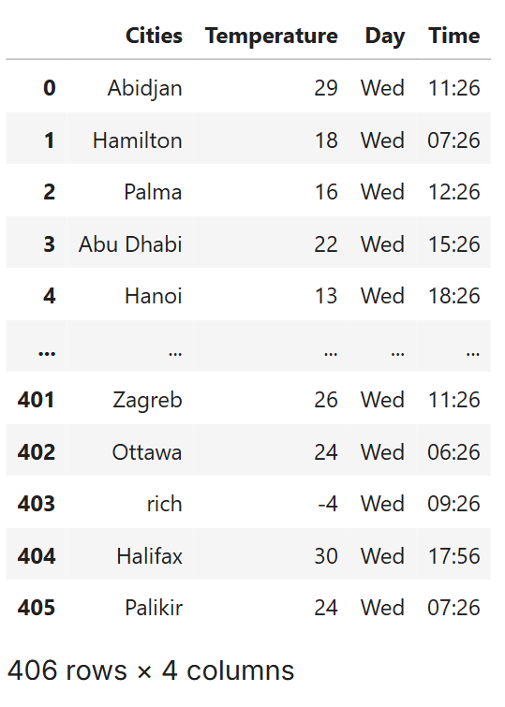
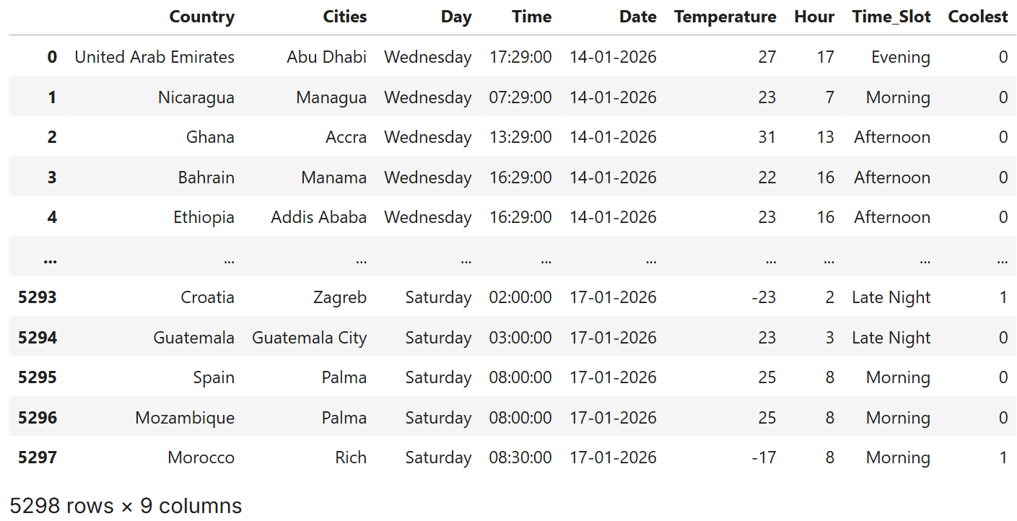
RAW DATA
After Added Features

Slide 9
CHALLENGES FACED WITH SCRAPING DATA
Inconsistent and missing temperature data across cities and time slots.
Dynamic website behaviour causes frequent data updates, so scraped data must be stored immediately to prevent changes or loss.
Some important features are not always available during scraping, leading to incomplete records.
Website restrictions and dynamic content make automated data collection challenging.
Data cleaning is required due to differences in formats, units, and time zones.

Slide 10
Data Collection and Data Understanding
DATA COLLECTION:
Weather data was collected from an online Date and Time website
The dataset contains raw temperature observations for different cities
DATA DESCRIPTION:
Temperature (°C) Current temperature of the Capital City in Celsius
Day Day of the week when data was collected
Date Date of the week when data was collected (Derived)
Time Local time of temperature observation (Derived using datetime logic)
City Name of the Capital City
  Country Name of the Country Of Capital City (Added via merge mapping
  Hour Hour is derived from Time for Analysis (Derived Column )
  Time_Slot Time_Slot referes to (Morning,Afternoon,Evening,Night)
  Coolest Coolest Temperature (Derived Using Condition )

Slide 11
DATA USAGE:
Used as raw input data for analysis
Further processed for data cleaning and transformation
Supports exploratory data analysis (EDA) and visualization
Helps in identifying temperature patterns across cities
DATA SCRAPING:
Scraped real-time weather data from a public website Date and Time website
Data collected for 7 consecutive days
Using Selenium Automation Tool I have Extracted The Data

Slide 12
Data Preprocessing(Cleaning)
Data Cleaning Process:
Identified and removed:
Missing values (nulls)
I Removed Country Columns Has 625 duplicated values
Invalid date and time entries
Standardized:
Date format (datetime64)
Time format (HH:MM:SS)
Ensured consistent data types across all columns

Slide 13
Added Features
Date & Time Engineering:
Created a date column using Python datetime module
Mapped day names (Monday–Sunday) to actual calendar
Date → datetime64 format
Ensured accurate day–date alignment
Time-Based Feature Creation
Extracted Hour from the Time column
Categorized time into Time_Slot for better interpretation
Defined time slots as: (Morning, Afternoon, Evening, Night)
Coolest Column Creation
The Coolest column is created to identify time periods with comparatively lower temperatures.

Slide 14
Pre-processed Global Weather Dataset:
Final dataset created after complete data preprocessing
Removed all duplicate and invalid records
Enhanced dataset with derived time-based features
Dataset is clean, structured, and analysis-ready
Dataset Size & Structure:
Total records: 4,673 rows
Total attributes: 9 columns
Covers multiple countries and capital cities
Data collected over 7 consecutive days
Final Dataset Columns
Dataset Has 9 columns
Country Cities (Capital City)
Day
Time
Date Temperature
Hour (Derived feature)
Time_Slot (Derived feature)
Coolest (Derived feature)

Slide 15
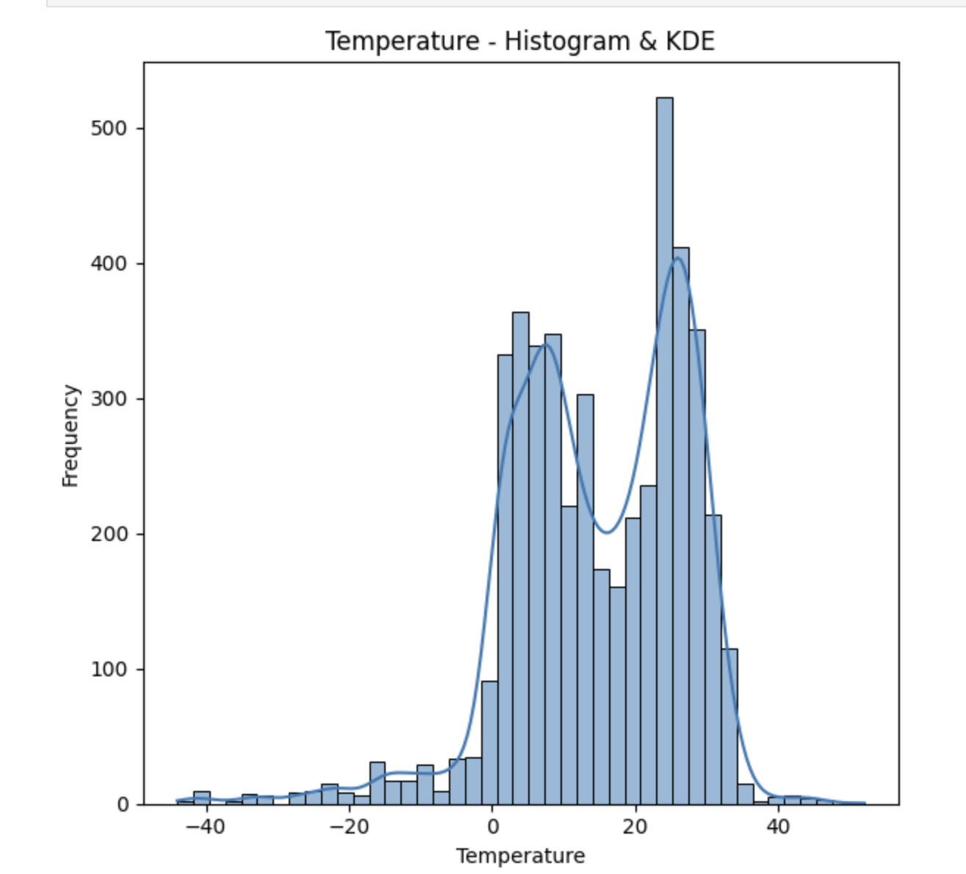
Exploratory Data Analysis (EDA)
Univariate Analysis
For Numerical Columns
Temperature Distribution
The histogram shows a broad spread of temperature values, indicating varied climate conditions across different locations and time periods.
Higher bar heights and peaks in the KDE curve reveal that most temperatures cluster within moderate ranges, representing commonly experienced and travel-friendly conditions.
The thinner tails at both ends of the distribution indicate that extreme hot and cold temperatures are relatively rare, making them less frequent travel scenarios.

Slide 16
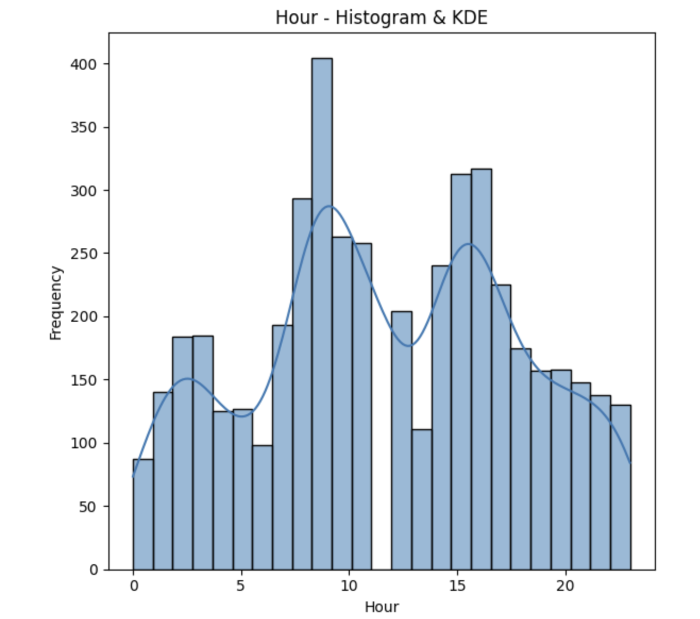
Hour Distribution
The data is spread across all hours of the day, indicating continuous weather observations throughout the day.
Noticeable peaks during morning and afternoon hours suggest higher data concentration during active daytime periods.
The KDE curve highlights time-based patterns, helping identify periods when temperature variations are more prominent.

Slide 17
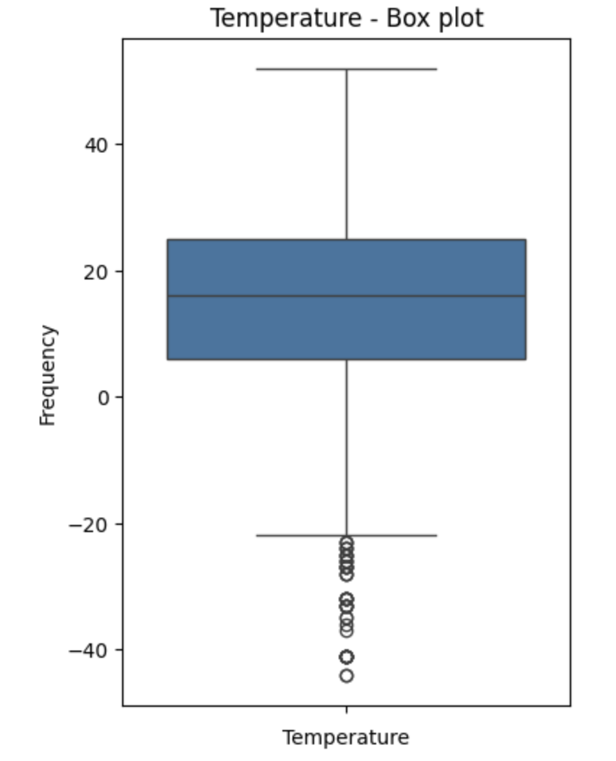
Temperature Box Plot – Key Insights
The median temperature falls within a moderate range, indicating generally comfortable climate conditions.
Most temperature values are tightly clustered, showing stable and consistent weather patterns.
A few extreme cold outliers are present, representing rare but unfavorable travel conditions.

Slide 18
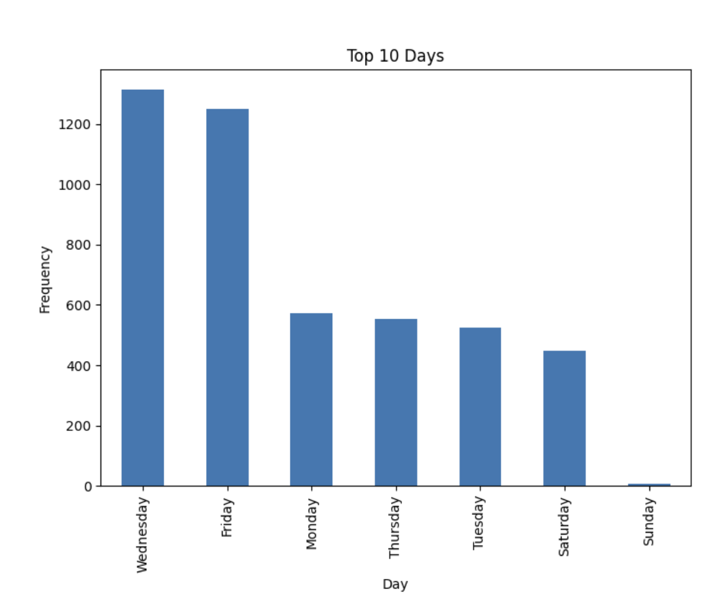
For Categorical Columns
Top Days Distribution
While scraping the data, most records were captured on Wednesdays and Fridays, resulting in higher frequencies for these days.
Weekdays show more data entries compared to weekends, indicating that data availability or updates were more consistent on working days.
Very few records were scraped on Sundays, suggesting limited data collection or reduced updates during weekends.

Slide 19
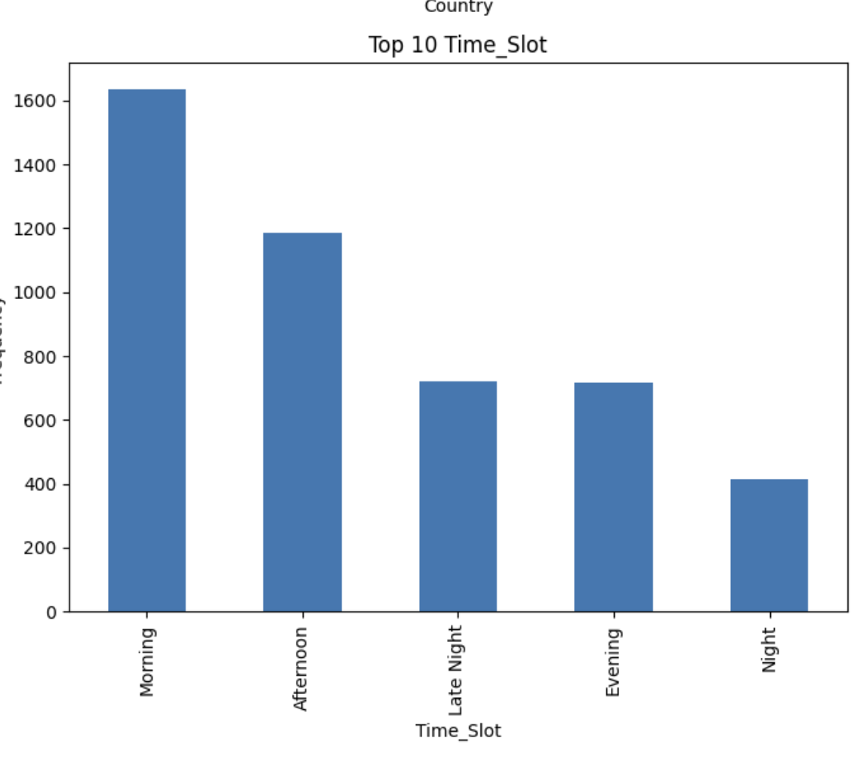
Time_Slot Distribution
Most records were captured during the Morning and Afternoon time slots, indicating higher data availability during daytime hours.
Evening and Late Night show moderate frequencies, reflecting reduced but consistent data collection during these periods.
The Night time slot has the lowest count, suggesting limited data scraping or fewer updates during late-night hours.

Slide 20
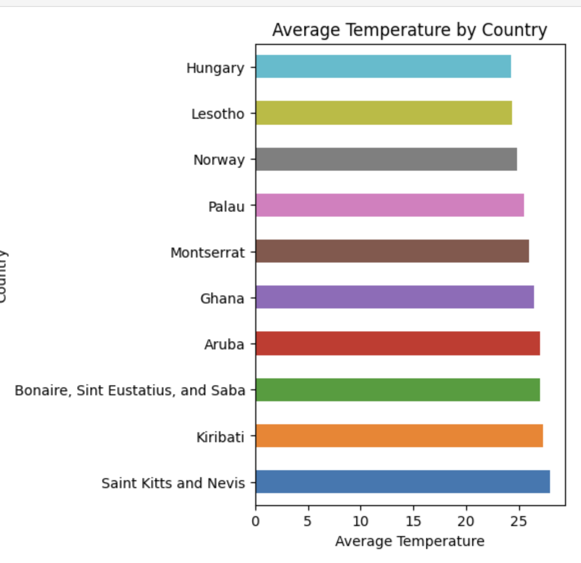
Bi-Variate Analysis:
Numerical VS Categorical
Average Temperature by Country – Key Insights
Saint Kitts and Nevis, Kiribati, and Aruba show the highest average temperatures, indicating consistently warm tropical climates.
Hungary and Lesotho record comparatively lower average temperatures, reflecting cooler or more moderate climate conditions.
The variation across countries highlights diverse climate profiles, supporting the need for climate-based travel recommendations tailored to user comfort.

Slide 21
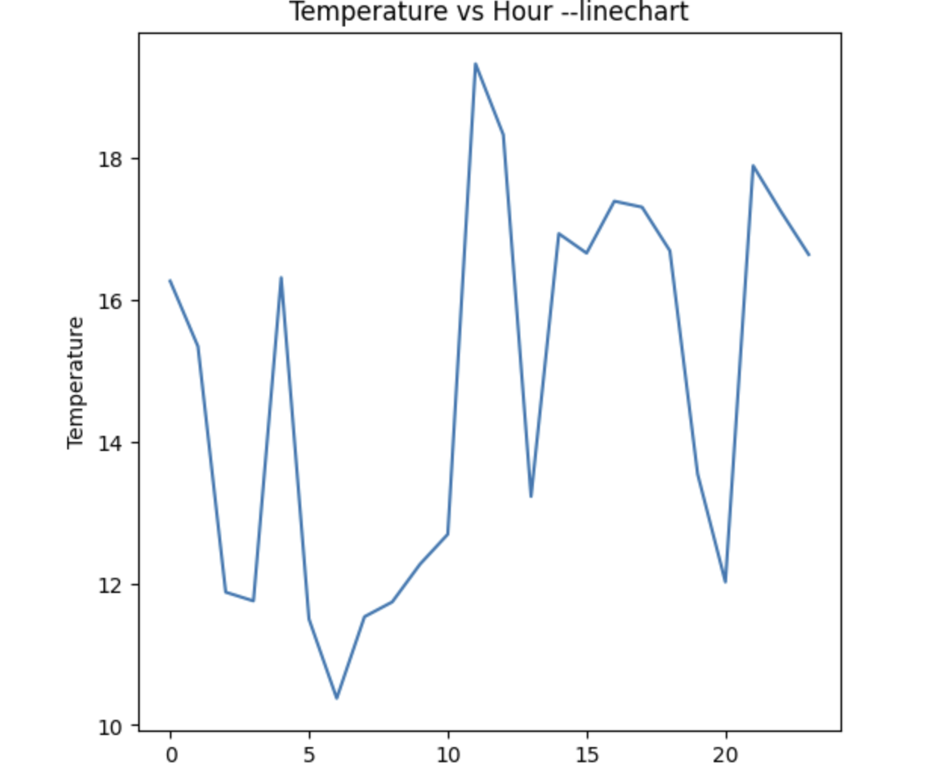
Numerical VS Numerical
Temperature vs Hour – Key Insights
Temperature fluctuates across the day, showing a clear hourly variation rather than a constant pattern.
Lower temperatures are observed during early morning and late evening hours, while higher values appear around midday to afternoon.
These variations help identify comfortable and cooler time slots, supporting time-based travel planning and recommendations.

Slide 22
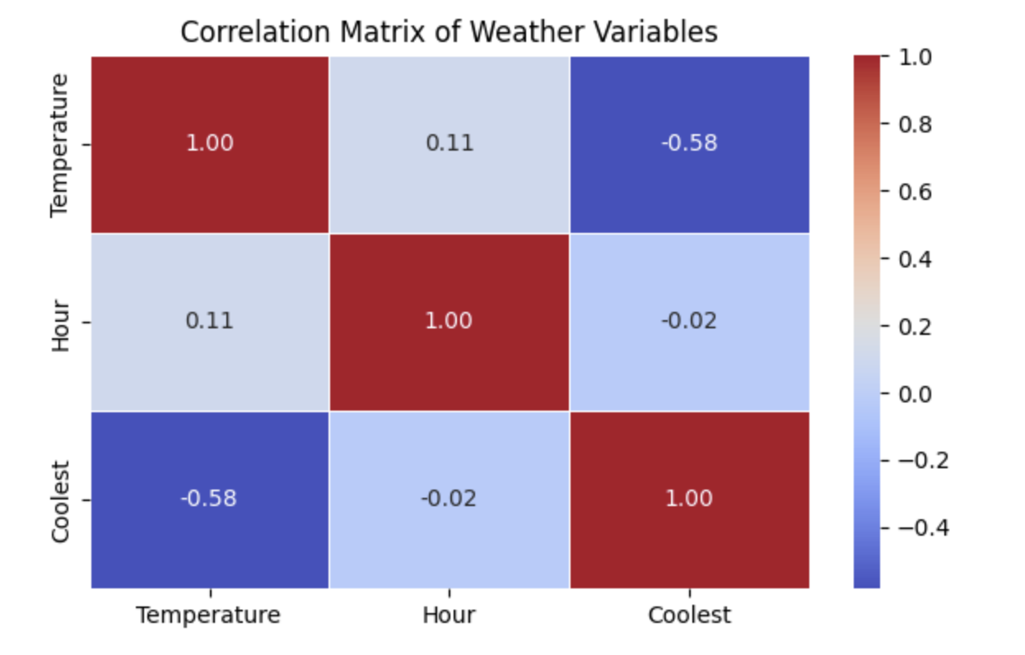
Multi-Variate Analysis
1.Temperature vs Coolest (−0.58)
Shows a moderate negative correlation
As temperature decreases, the Coolest indicator increases
Confirms that Coolest effectively captures comfortable temperature conditions
2. Temperature vs Hour (0.11)
Indicates a very weak positive relationship
Temperature slightly increases during later hours, but not strongly
Suggests time alone is not sufficient to determine climate comfort
3. Hour vs Coolest (−0.02)
Almost no correlation
Coolest conditions are not strictly time-dependent
Reinforces the need for actual temperature data, not just time-based assumptions

Slide 23
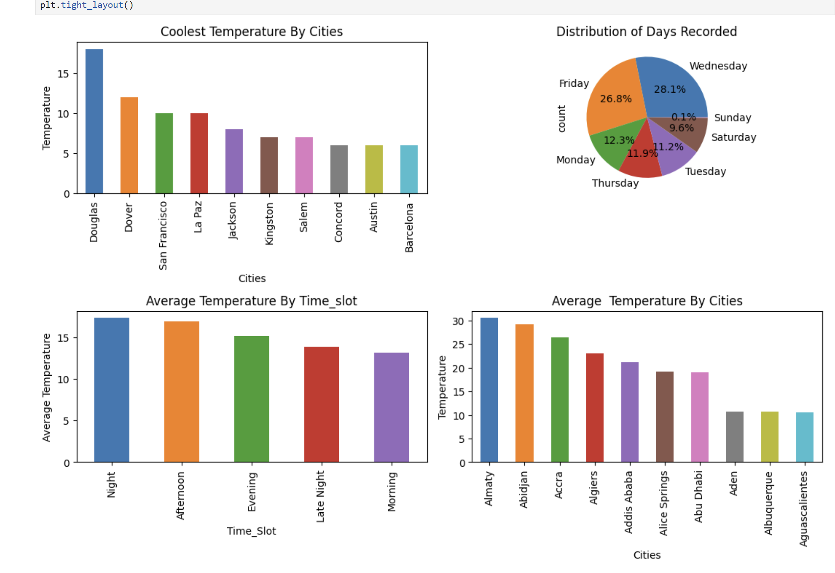

Slide 24
Evaluation(Hypothesis Testing)
Time Slot vs Temperature
Null Hypothesis (H₀):
There is no significant difference in average temperature across different time slots (Morning, Afternoon, Evening, Night).
Alternative Hypothesis (H₁):
There is a significant difference in average temperature across different time slots.
A one-way ANOVA test was performed to compare the average temperature across different time slots (Morning, Afternoon, Evening, Night).
The test result showed a statistically significant difference in mean temperatures between at least one pair of time slots.
Since the p-value was less than the significance level (α = 0.05), the null hypothesis (H₀) was rejected, confirming that temperature varies meaningfully across time slots.

Slide 25
City-Wise Temperature Difference
Null Hypothesis (H₀): There is no significant difference in average temperature between Cities.
Alternative Hypothesis (H₁): Average temperature differs significantly between Cities.
A one-way ANOVA test was conducted to compare the average temperatures across different cities.
The test results indicated a statistically significant difference in mean temperatures among the cities.
Since the p-value was less than the significance level (α = 0.05), the null hypothesis (H₀) was rejected, confirming that temperature varies significantly from city to city.

Slide 26
Night vs Day Temperature
Null Hypothesis (H₀): Night-time temperatures are not significantly lower than daytime temperatures.
Alternative Hypothesis (H₁): Night-time temperatures are significantly lower than daytime temperatures.
A statistical hypothesis test was conducted to compare night-time and daytime average temperatures.
The test results showed that night-time temperatures are significantly lower than daytime temperatures.
Since the p-value was less than the significance level (α = 0.05), the null hypothesis (H₀) was rejected, supporting the alternative hypothesis.

Slide 27
Conclusion:
Temperature varies significantly by hour of the day, with cooler periods in early morning and late evening and warmer conditions around midday.
Average temperature differs notably across countries, highlighting diverse climate profiles ranging from cooler regions to consistently warm destinations.
Both time-based and location-based temperature patterns are important for identifying comfortable travel conditions.

Slide 28
Recommendations & Suggestions:
Recommend moderate-average temperature countries (such as Hungary, Lesotho, and Norway) to travellers seeking comfortable and less extreme weather conditions.
Suggest warm-average temperature destinations (such as Aruba, Kiribati, and Saint Kitts and Nevis) for users who prefer tropical climates, along with guidance on suitable travel times.
Use average temperature profiles to personalize destination recommendations, aligning traveller preferences with climate comfort and reducing weather-related dissatisfaction.

Slide 29


Slide 30

THANK YOU

